Slide 1

Commodities Visualization analysis using Web Explorer
Batch no. 81
1. 2211CS010284(K. Sai Krishna)
2. 2211CS010322(P. Narender)
3. 2211CS010272(K. Abyudhay)
4. 2211CS010308(K. Srikar Reddy)
Guide
Dr.K.RaviTeja

Slide 2
Table of Content
Introduction
Literature Survey
Limitations of Existing Algorithms/Methodologies
Abstract
Proposed Methodology
Hardware/Software Requirements
Conclusion
References

Slide 3
Introduction
The project focuses on analyzing daily price trends of various commodities across multiple markets in India. By leveraging this dataset, we aim to gain insights into pricing patterns, variations across regions, and other factors influencing market behavior. This study has significant implications for stakeholders, including farmers, traders, and policymakers.
This analysis provides actionable intelligence to stakeholders, such as farmers, traders, policymakers, and supply chain managers, enabling better decision-making, price forecasting, and market planning. Moreover, the findings aim to bridge existing gaps in understanding market efficiencies and bolster efforts towards stabilizing commodity prices.
Built using Streamlit, Pandas, Matplotlib, and Seaborn, this application offers interactive data visualizations, enabling to make informed decisions .

Slide 4
Literature Survey
Numerous studies have explored commodity price trends using data analytics. Common methodologies include time series analysis, regression models, and machine learning approaches for forecasting prices. These studies emphasize the importance of analyzing regional variations, the impact of weather, and supply-demand dynamics. However, they often overlook real-time trends and inter-market comparisons, which this project addresses.
Study 1: A 2020 study by Singh et al. utilized ARIMA models to forecast wheat prices in northern India, demonstrating the importance of seasonality in price prediction.
Study 2: A research paper by Sharma and Gupta (2021) analyzed the impact of monsoon rainfall on rice pricing using regression techniques, highlighting weather's influence on supply chains.
Study 3: An application of LSTM neural networks by Patel et al. (2022) provided accurate short-term predictions for vegetable markets in western India, showcasing the potential of deep learning

Slide 5
Limitations of Existing Algorithms/Methodologies
Limitations of Existing Algorithms/Methodologies
Limited Data Scope: Most existing approaches focus on a narrow set of commodities or regions.
Static Models: Many algorithms fail to adapt to real-time data fluctuations.
Poor Integration: Lack of integration between market-level data and broader economic indicators.
Interpretability Issues: Complex machine learning models often lack transparency, making it difficult for stakeholders to understand results.

Slide 6
Abstract
Commodity market visualization analysis is essential for tracking price fluctuations, supply demand trends, and trading volumes across various sectors, including energy, metals, and agriculture. This analysis leverages data visualization tools such as Tableau, Power BI, Python (Matplotlib, Seaborn), and D3.js to transform raw market data into interactive and insightful representations. By utilizing these tools, investors, traders, and analysts can better interpret complex datasets, identify market patterns, and make informed decisions. The integration of real-time data with visualization techniques enhances forecasting accuracy, risk assessment, and strategic planning in commodity trading. Our approach integrates statistical analysis and visualization techniques to identify key trends and anomalies. By addressing existing limitations, we propose a more dynamic and interpretable methodology to analyze and forecast commodity prices, offering actionable insights for market stakeholders.

Slide 7
Proposed Methodology
Data Cleaning and Preprocessing: Handling missing values, correcting anomalies, and formatting the dataset.
Exploratory Data Analysis (EDA): Identifying trends, seasonal patterns, and outliers through visualizations.
Trend Analysis: Using statistical methods to analyze price trends over time and across regions.
Forecasting Models: Implementing machine learning models such as ARIMA, LSTM, or Prophet for price prediction.
Regional Comparisons: Examining inter-market differences to identify price disparities.
Dashboard Creation: Building an interactive dashboard for real-time monitoring and analysis.

Slide 8
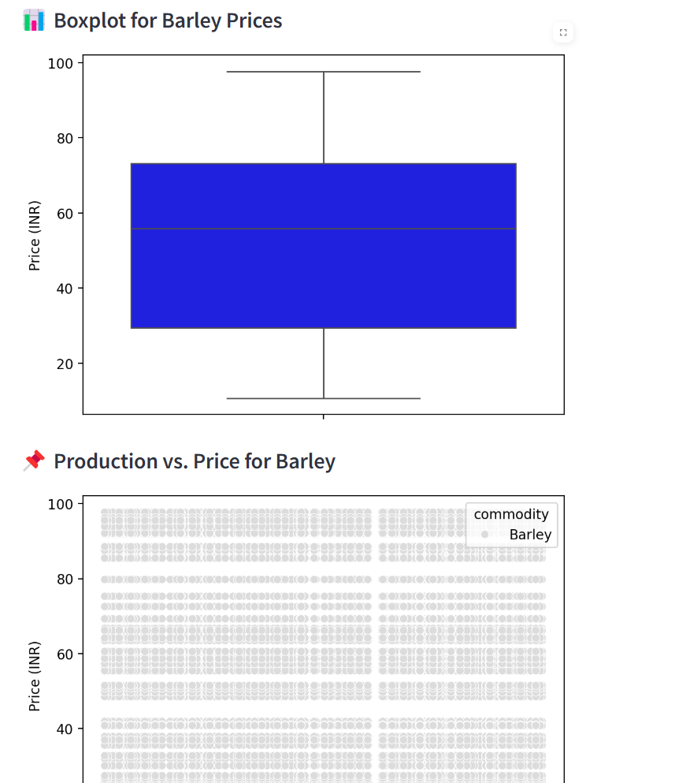
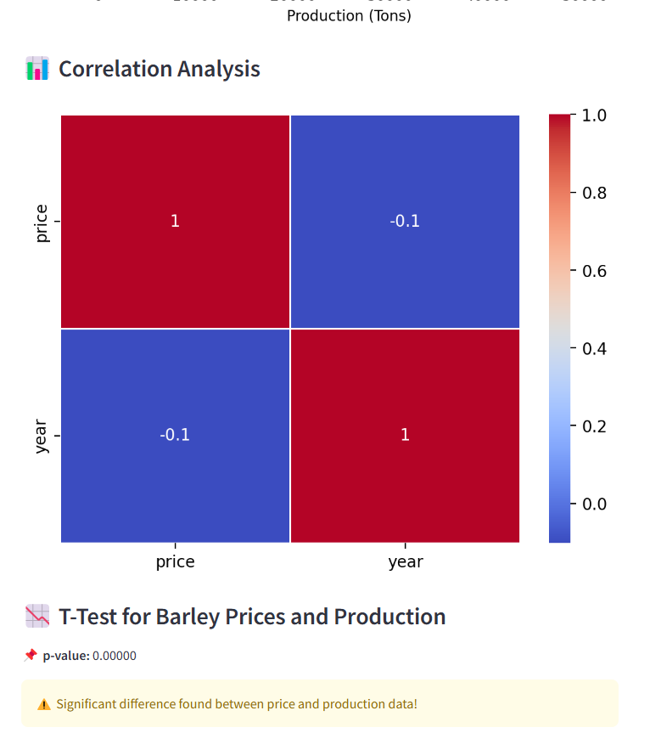
Screen-Shots of working model

Slide 9
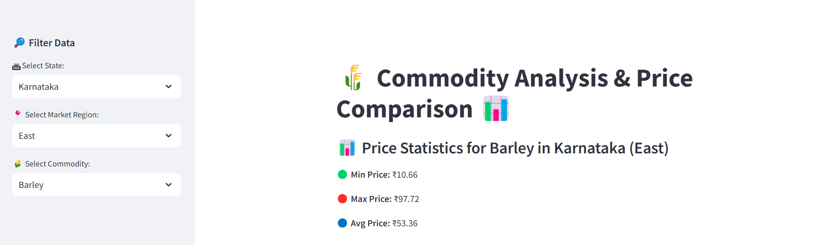
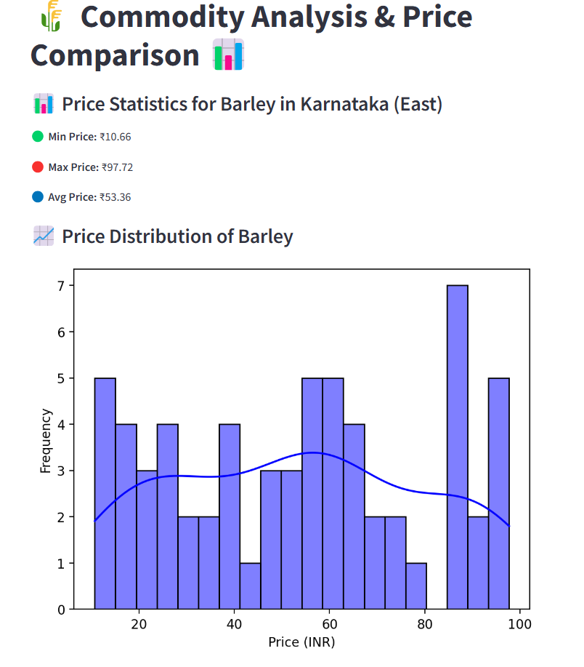

Slide 10
Conclusion
This project underscores the critical role of data analytics in addressing the complexities of commodity pricing. By systematically analyzing daily price trends across multiple markets, this study provides valuable insights into market dynamics, regional disparities, and seasonal variations. The proposed methodology not only empowers stakeholders such as farmers, traders, and policymakers to make informed decisions but also contributes to enhancing market transparency and efficiency. Furthermore, the integration of predictive models and interactive dashboards offers scalable solutions for real-world applications, paving the way for proactive pricing strategies and better resource allocation. This work sets a strong foundation for future research aimed at optimizing agricultural markets and supporting sustainable economic development.

Slide 11
References
Singh, R., & Sharma, P. (2020). "Time Series Analysis of Wheat Prices in India." Journal of Agricultural Economics, 45(3), 230-245.
Patel, K., & Desai, R. (2022). "Using LSTM for Short-term Vegetable Price Forecasting." International Conference on Machine Learning Applications, 112-118.
Kumar, M., & Yadav, S. (2019). "Clustering Techniques for Analyzing Market Price Variations of Pulses in India." Journal of Data Science and Applications, 10(4), 389-405.
Documentation of Python libraries: Pandas, Matplotlib, Seaborn, and Scikit-learn (https://pandas.pydata.org/).
Government of India. (2023). "Commodity Market Trends Report." Ministry of Agriculture and Farmers Welfare.

